Slide 1
CSS FOUNDATION FRAMEWORK.
Title: "Building a CSS Foundation Framework"
Name: [ABDUL RAHEMAN]
Date: [17/11/2024]

Slide 2
What is Foundation?
Definition: Foundation is a responsive front-end CSS framework for building modern web interfaces.
Developed By: Zurb.
Purpose: To provide a scalable, modular, and flexible foundation for web design.
Key Features:
Mobile-first
Prebuilt components
Customizable

Slide 3
Introduction to Foundation
Foundation is a free responsive front-end framework, providing a responsive grid and HTML and CSS UI components, templates, and code snippets, including typography, forms, buttons, navigation and other interface elements, as well as optional functionality provided by JavaScript extensions.
Purpose: A responsive front-end framework for building websites.
Simple, mobile-first approach with pre-styled components.

Slide 4
Installation and Setup
We can add Foundation CSS JavaScript to our webpage in 2 ways:
Using NPM Install
Using CDN
Using NPM Install:
Foundation is available on npm. This package includes all of the source Sass and JavaScript files, as well as compiled CSS and JavaScript, in uncompressed and compressed flavors.
Using CDN Link:
We can get the required foundation JS from CDN by just inserting the below lines of code in our HTML template:
JavaScript Initialization:
The .foundation() function on the jQuery object, can be utilized to avail every Foundation plugin at once.

Slide 5

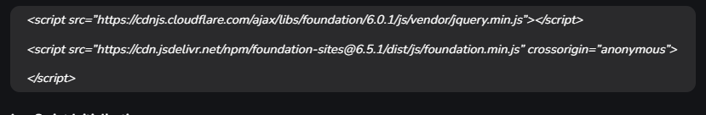
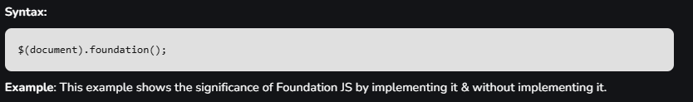
Using Npm syntax:
Using CDN links :
JavaScript Initialization:

Slide 6
Buttons in Foundation
Simple button styles using classes like button, primary, alert, warning etc.
Foundation provides different button styles for quick use.
Example Code:
html
<button class="button primary">Primary Button</button>
<button class="button secondary">Secondary Button</button>
<button class="button alert">Alert Button</button>
Visual Example: Screenshot of the different button styles.

Slide 7
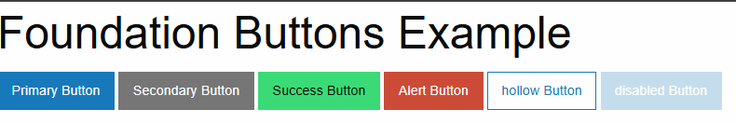

Slide 8
Navigation Bar Example
To create a basic navigation bar using Foundation's menu class.
Navigation is responsive by default.
Example Code:
html
<ul class="menu">
<li><a href="#">Home</a></li>
<li><a href="#">About</a></li>
<li><a href="#">Services</a></li>
<li><a href="#">Contact</a></li>
</ul>

Slide 9

Navigationbar output example :

Slide 10
Forms in Foundation
Basic form styling with Foundation's input and form elements.
Example of a simple form with inputs and a submit button.
Example Code:
html
<form>
<label>Name
<input type="text" placeholder="Your Name">
</label>
<label>Email
<input type="email" placeholder="example@domain.com">
</label>
<button type="submit" class="button primary">Submit</button>
</form>

Slide 11
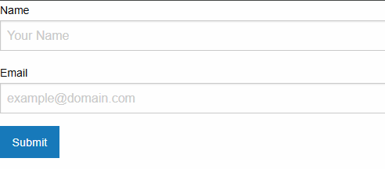
Forms In foundation output example :

Slide 12
Creating a Card with Foundation
To create a card using Foundation's there are classes to callout the component.
it are useful for grouping content with borders or background.
Example Code:
html
<div class="callout">
<h5>Card Title</h5>
<p>This is a simple card example using a Foundation callout.</p>
<a href="#" class="button small">Read More</a>
</div>.

Slide 13
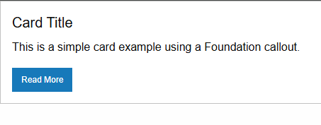
Card foundation output example :

Slide 14
Foundation's Responsive Images
To make images responsive with Foundation's thumbnail class.
Demonstrates automatic scaling for different devices.
Example Code:
html
<img src="example.jpg" class="thumbnail" alt="Responsive Image Example">
Visual Example: An image adjusting its size on different screen widths.

Slide 15
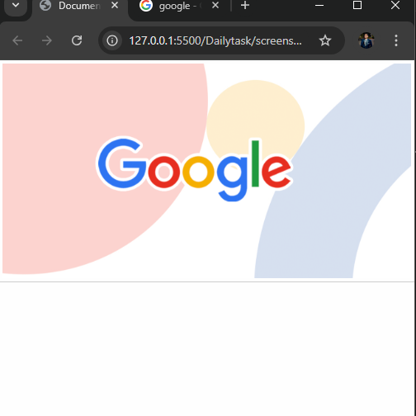
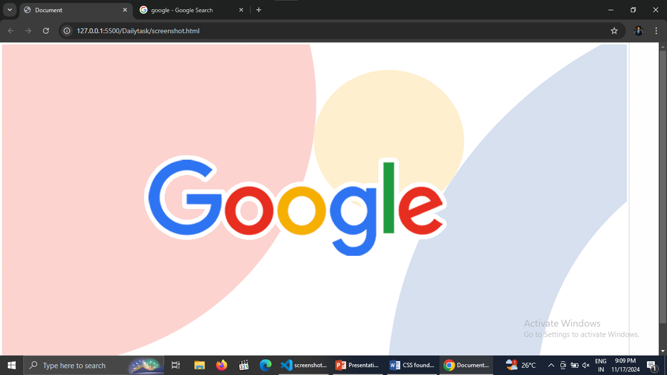
Responsive image foundation output example :

Slide 16
Foundation Grid System
Foundation is a CSS framework based on the “grid system”. This system allows developers to lay out a web page in a very ordered, easy manner. It uses a mobile first approach meaning that if you build a grid system for a small mobile device, it can also be used for medium and large devices.
The foundation grid is based on a 12-column layout.
Example Code:
html
<div class="grid-container">
<div class="grid-x grid-padding-x">
<div class="cell small-6">50% Width (Small)</div>
<div class="cell small-6">50% Width (Small)</div>
</div>
</div>
Visual Example: Diagram with two side-by-side boxes, each occupying 50% width.

Slide 17
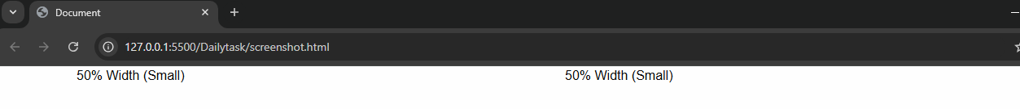
Foundationgrid output example :

Slide 18
Modal Example in Foundation
A modal can open another modal with the help of id and data-open attribute.
Modals can be triggered with buttons or links.
Example Code:
html
<!-- Trigger Button -->
<button class="button" data-open="exampleModal">Open Modal</button>
<!-- Modal Content -->
<div class="reveal" id="exampleModal" data-reveal>
<h1>Simple Modal Example</h1>
<p>This is a modal window with some sample content.</p>
<button class="close-button" data-close>&times;</button>
</div>

Slide 19
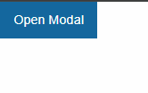
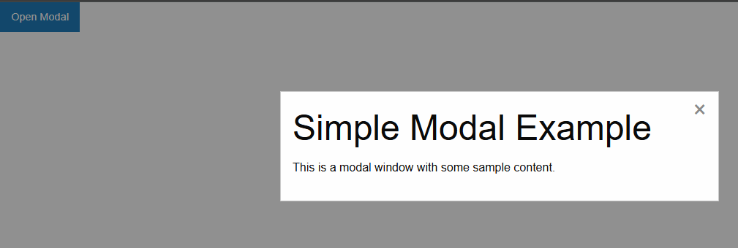
Modal output example :

Slide 20
Foundation Typography
Typography in Foundation is meant to make your life easier by providing clean, attractive, simple default styles for all of the most basic typographical elements.
Examples of Foundation's pre-defined typography classes.
Showcasing headings, paragraphs, and text styles.
Example Code:
html
<h1>This is a Heading 1</h1>
<p class="lead">This is a lead paragraph with emphasized style.</p>
<p>This is a standard paragraph.</p>
Visual Example: A screenshot of various text styles with different fonts.

Slide 21
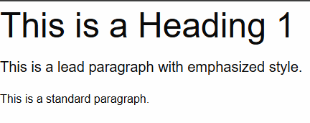
Typography foundation output example :

Slide 22
Responsive Footer Example
Example of a simple responsive footer with multiple columns.
Use Foundation’s grid system to layout the footer.
Example Code:
html
<footer class="grid-x grid-padding-x">
<div class="cell small-6 medium-4">© 2024 My Website</div>
<div class="cell small-6 medium-4">Links</div>
<div class="cell small-12 medium-4">Contact Info</div>
</footer>
Visual Example: A simple, multi-column footer layout.

Slide 23
Responsivefooter example output :

Slide 24
resources:
Encourage hands-on practice with Foundation's examples.
https://get.foundation/ to official documentation and further resources.
Q&A open for questions.

Slide 25
Thank You.
.

